Slide 1
Welcome!
Please, have a seat.
CWRU Quants
quants@case.edu
Notes:
CHristo

Slide 2
AGENDA
Event Recaps
Placement Updates
Types of Securities
Measures of Risk and Return
Why Diversify?
Intro to Portfolio Theory
Vote
Notes:
Christo

Slide 3
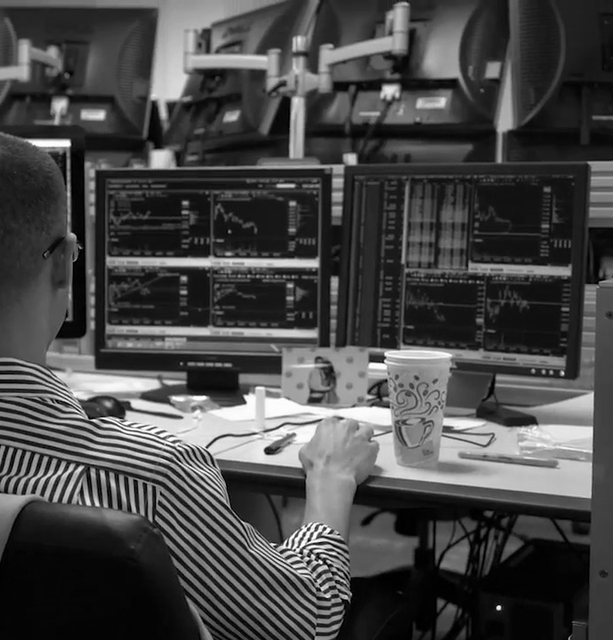
EVENT RECAP
Notes:
Christo

Slide 4

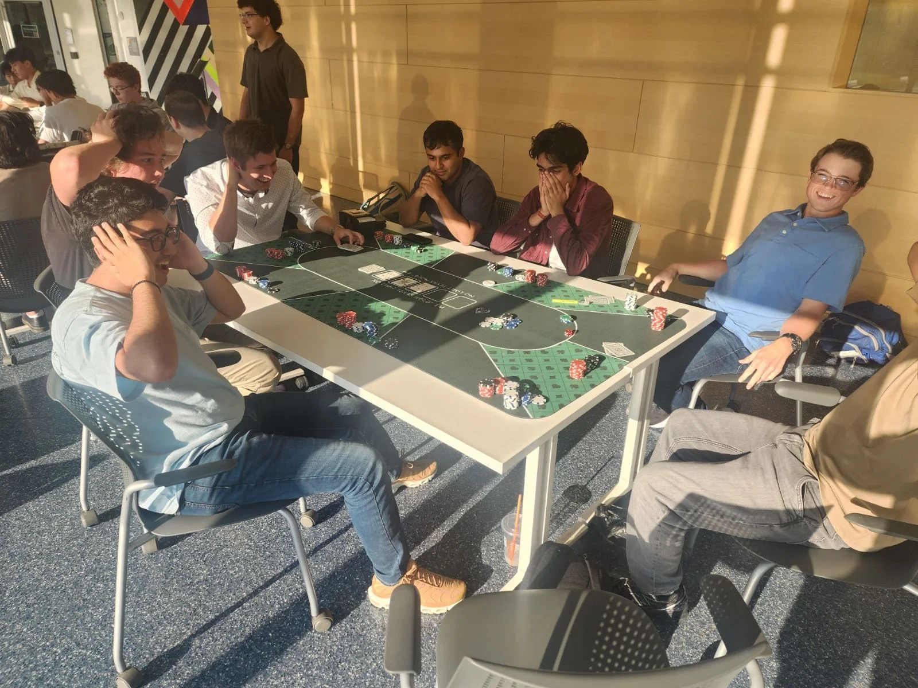

Notes:
Ethan

Slide 5
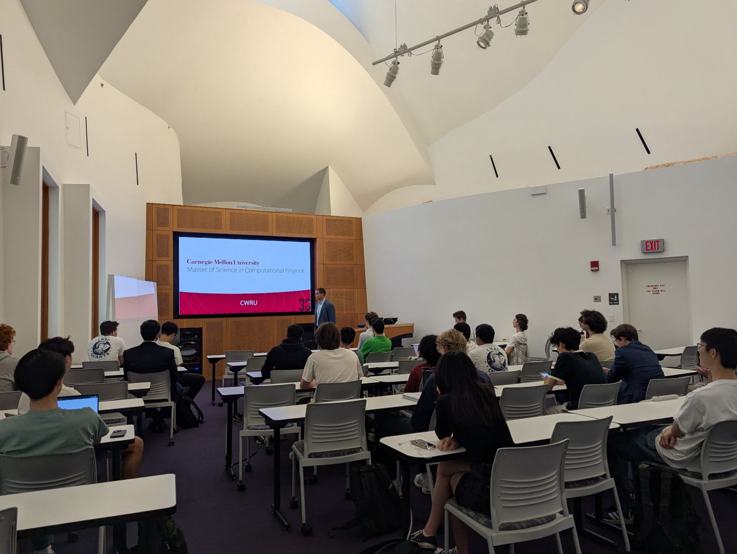
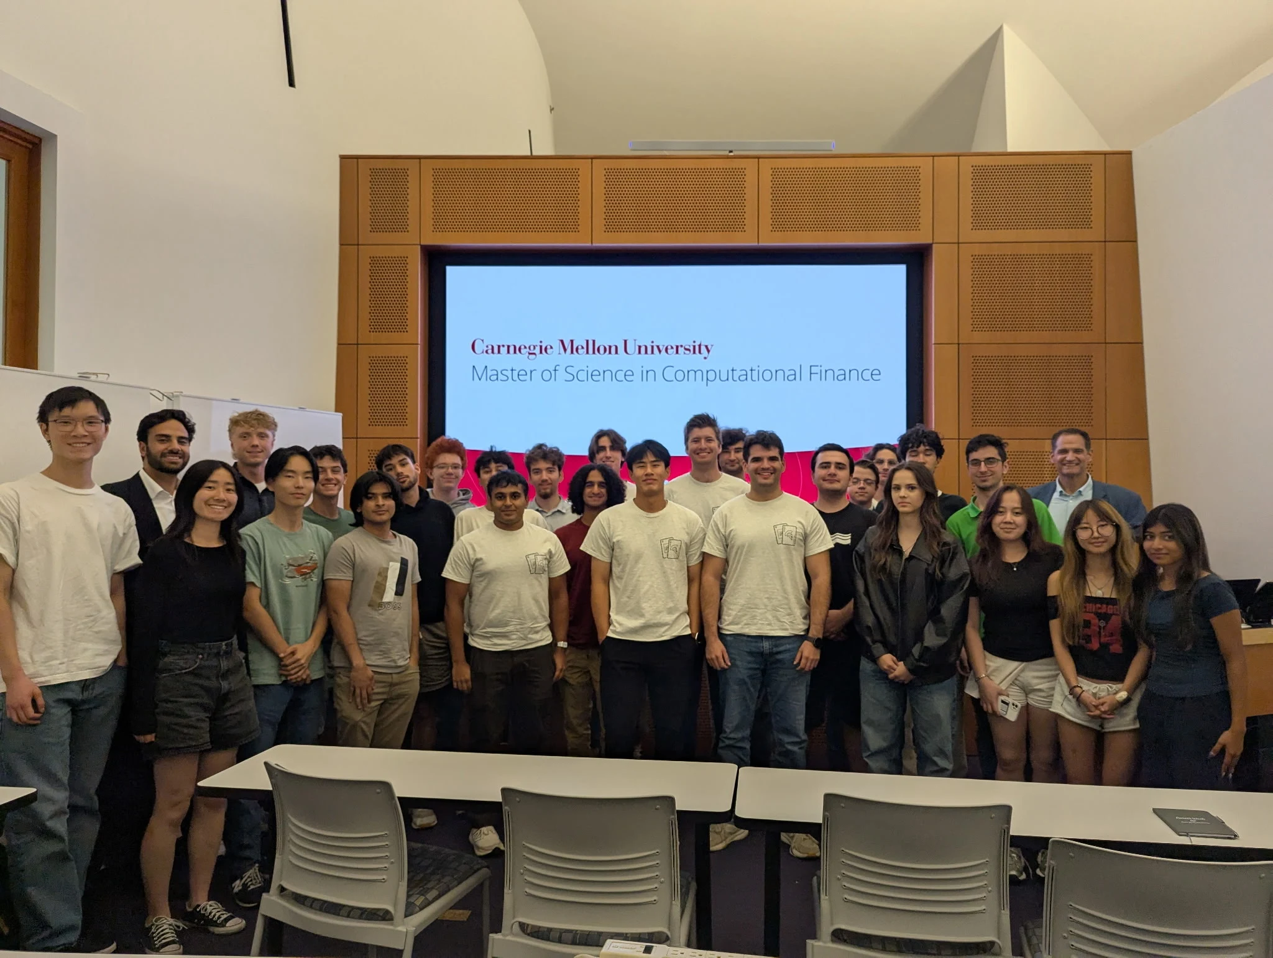
Notes:
Ray Ikome
The finance industry in the last 2-3 decades has undergone a transformation. Deregulation and technological advancements resulted in competing markets and reduced execution costs

Slide 6
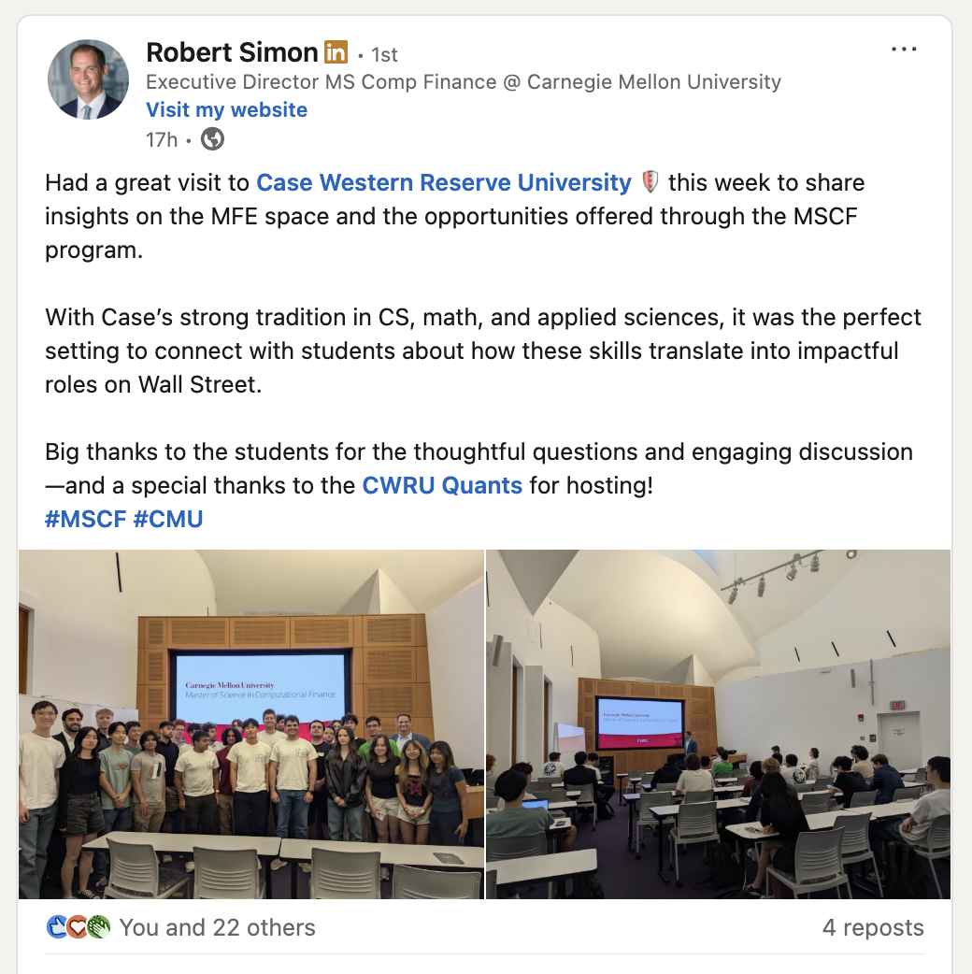
Notes:
Ethan

Slide 7
PLACEMENT UPDATES
Notes:
Christo

Slide 8


Placement Updates:
x3 Quant Interns
x1 Data Sci Intern
Notes:
Everyone

Slide 9
Types of Securities
Notes:
Ray Ikome

Slide 10
security - tradable financial asset that holds monetary value and represents a financial claim
(e.g. ownership in a company, creditor relationship with government or corporation, etc.)
The purpose of securities is to allow investors to earn financial returns, while enabling issuers to raise capital for projects, expansion, or whatever they need $ for.
Notes:
Ethan

Slide 11
Securities vs. Commodities
Commodities (oil, gold, wheat) are physical goods with intrinsic value, not financial contracts.
however, you can have securities (futures, etfs, etc.) based off of commodities. Such as an etf that tracks gold, real estate, etc.
Notes:
Ray Ikome
The finance industry in the last 2-3 decades has undergone a transformation. Deregulation and technological advancements resulted in competing markets and reduced execution costs

Slide 12
Types of Securities
equities (stocks)
ownership in a company, voting rights, dividends
ex: $AAPL, $TSLA
ETFs (exchange-traded funds)
ex: $SPY, $QQQ
fixed income (bonds)
debt instruments paying coupons + principal amount
government bonds, corp bonds, municipal bonds
derivative instruments (based off of equities or bonds)
options, futures, swaps (we will discuss this next week)
Notes:
Ethan

Slide 13
What is an ETF?
collection of securities or commodities into a buyable “package” that contains a certain theme
people can make ETFs to track almost anything
ex: ARKK
ex: SPY
Nvidia
25%
Intel
25%
TSMC
25%
AMD
25%
Notes:
Ray Ikome
The finance industry in the last 2-3 decades has undergone a transformation. Deregulation and technological advancements resulted in competing markets and reduced execution costs

Slide 14
Why would you want to invest in an ETF?
instant diversification
low effort vs. building your own portfolio
easy exposure to markets
hedging
thematic investing
believe in AI? buy an AI ETF
believe in future of clean energy? buy a clean energy ETF
Notes:
Ethan

Slide 15
Measures of Risk and Return
Notes:
Christo

Slide 16
Returns
How do we compute returns of a security?
We can compute the difference between the current price of a security and the prior price of the security divided by that prior price
This will give you the % return of a security over some time period
Notes:
Karel

Slide 17
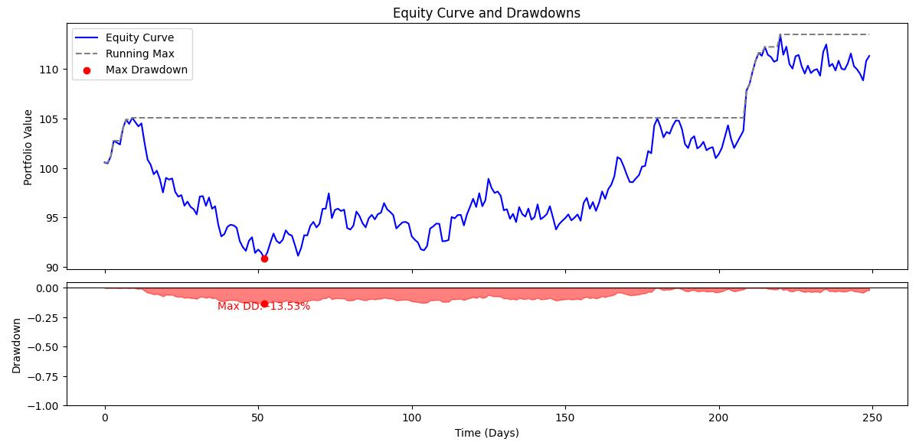
Drawdowns
Drawdown (broadly): The measure of decline from a historical peak of some asset
A fundamental measure of risk
Maximum Drawdown: The largest difference between a peak and trough
Average Drawdown: The time average of drawdowns up to a time T
Notes:
Karel

Slide 18
Covariance & Correlation
Covariance
-Statistical concept that intuitively measures how closely two random variables “move” together
-A positive covariance: They move in the same direction
-A negative covariance: They move in opposite directions
Correlation
-Similar to covariance, and is actually derived from it, though it is bounded between -1 and 1
* In practice these are arranged in a covariance matrix for multiple assets
Notes:
Karel

Slide 19
Beta
A measure of how volatile a specific security is compared to the overall market (S&P 500 or similar)
Calculated as the covariance between some security and the overall market, divided by the variance of market returns
Just the slope of the regression line of the security’s returns vs. the market’s returns
𝛽<1: less volatility than the market
𝛽=1: market returns and security move in line
𝛽>1: more volatility than the market
Notes:
Karel

Slide 20
Question: Suppose that we have the QQQ, and a leveraged ETF named TQQQ, that returns 3x the return of QQQ on a given day.
For example, if QQQ returned +1% today, then TQQQ returns +3%. If QQQ returns -1%, TQQQ returns -3%.
Say you are a prospective investor.
What is a situation where you would want to buy QQQ vs. TQQQ? Which would you hold long term?

Slide 21
Diversification
Notes:
Christo

Slide 22
What is diversification?
reducing risk of a single “black swan” event destroying your entire portfolio
the “smart” investor wants to protect their money, especially if they are less risk averse
by diversifying, you can turn a “really bad day” in the market into just a “bad day”
Notes:
Ethan

Slide 23
This is why people recommend beginner investors to buy ETFs
spread out your risk to just the overall market, not overexposed to a single industry
You also spread out your exposure to opportunities
trade war: consumer goods might suffer
but if you have money in tech, you’re probably doing well right now
through diversification, you can capture growth across different sectors

Slide 24
Intro to Modern Portfolio Theory
Notes:
Christo

Slide 25
Why do you invest?
Notes:
Ethan

Slide 26
Why do you invest?
To increase your net worth!
translating this into portfolio theory terms…
Notes:
Ethan

Slide 27
modern portfolio theory - framework for assembling portfolio of assets such that the expected return is maximized for a given level of risk
assumption that investors are risk averse, meaning that given 2 portfolios that offer the same expected return, investors will prefer the less risky one.
So an investor will take on increased risk only if compensated by higher expected returns.
Notes:
Ethan

Slide 28
The expected return of the portfolio is calculated as the weighted sum of the returns of the individual assets.
If you have a portfolio containing 4 equally weighted assets with expected returns of 4%, 6% and 10%, then the expected return would be:
(0.33)(0.04) + (0.33)(0.06) + (0.33)(0.10) = 0.066

Slide 29
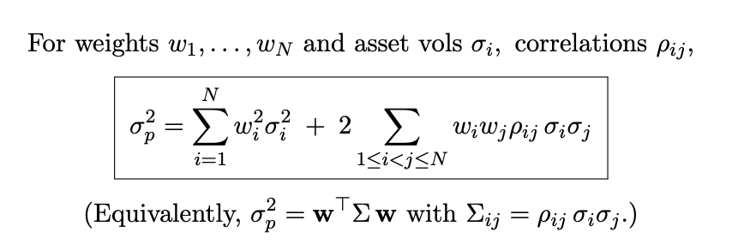
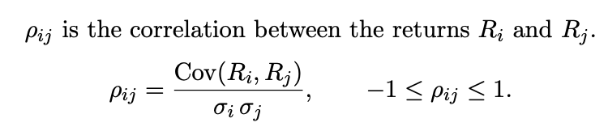

Slide 30
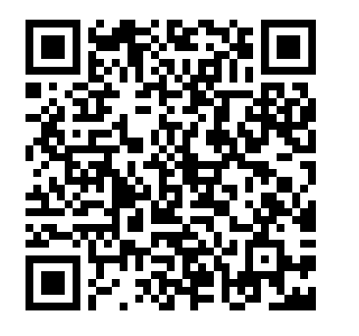
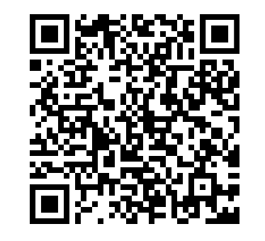
Practice
Answer Key

Slide 31
Coming next week….
Notes:
Christo

Slide 32
Next week…
Options 101
Notes:
Ethan

Slide 33
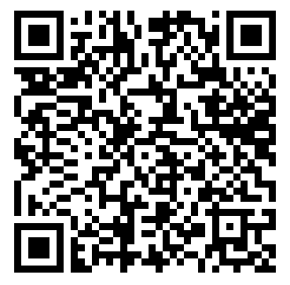
Vertical Cohort Application

Slide 34



Social Links
@cwruquants
@cwruquants
@cwruquants
Notes:
CHristo

Slide 35
QUESTIONS
AND ANSWERS
Contact us!
Email: quants@case.edu
Instagram: @cwruquants
Notes:
Sid

